Slide 1

The Canadian Podcast Listener Analysis 2018
By Aimin Amy Hu

Slide 2
Abstract
The term of podcasting comes from a combination of the words iPod and broadcasting.
Free service
Used for entrainment, information, education
Doesn’t have long history
Podcasts’ listeners increase every year

Slide 3
Challenge
Podcasters reply on ads for their finance support
Free downloads the podcast episodes but not get much information from the listeners
Not much data for analyzing the listeners
Collecting data from survey form with many un-responded questions

Slide 4
Audience Insights Inc
is a media research consultancy
to meet just about any assignment facing clients
Whether it’s building audience, driving ad revenue, understanding impact of marketing or activating digital opportunities

Slide 5
Research Questions
To what extent is income affecting people listening podcast?
To what extent are gender and age affecting people listening podcast?
To what extent are devices affecting listeners of podcasts?
What are the popular 10 podcasts listed from the survery data?
How listeners react to the advertising in podcasts?

Slide 6
Objectives
To help Canadian podcast publishers and advertisers understand more about how to target different segments of podcast listeners
To inform business opportunities in this growing media sector

Slide 7
Method and Language
Method: Market Segmentation
R will be the language for this project

Slide 8

Data Understanding
Dataset : 2018 Canadian Podcast Listeners’ data. Collected from survey form
Data Summary
1534 observation
584 variables
Among 584 variables, 184 variables(columns) have NA for all values

Slide 9
Data Visualization - Listeners’ Demographics
Gender and age distribution
Household size and Kids in Household

Slide 10
Listeners’ Education and Household Income
Respondents' education level and Work Status
Respondents’ household income before tax

Slide 11
A Pie Chart of First Started Listening to Podcasts

Slide 12
Data Analysis: Top 10 List of Podcasts
Top 10 genres between male and female

Slide 13
Top 10 Favorite Podcasts

Slide 14
Segmentation Analytics
Segmentation provides the knowledge that companies need to tailor their products and services to maximize their profits within each segment.
Expecting to identify more profitable segments for ads.

Slide 15
Cont.
Selected variables based on research questions
Variables of Demographics of Listeners
Variables of listeners' Recency and Frequency
Variables of how listeners' reacting to ADS
Subset data

Slide 16

K - Modes Clustering
Unsupervised process of partitioning a group of data objects into clusters.
K-modes algorithm extends the k-means paradigm to cluster categorical data
Partitioning Around Medoids (PAM) algorithm
Dissimilarity Matrix Calculation: Gower distance
gower_dist <- daisy(df_final[,2:17], metric = "gower")
gower_mat <- as.matrix(gower_dist)

Slide 17

Cont.
Determining Optimal Clusters: Silhouette Coefficient
K= 3 yields the highest value (The metric can range from -1 to 1, where higher values are better)

Slide 18
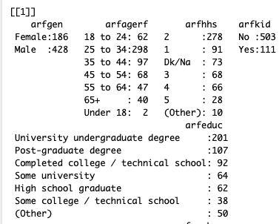
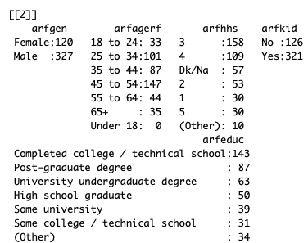
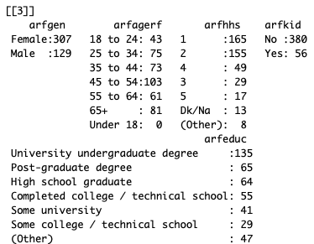
Applying K-Modes(PAM) and Summary of Each Cluster
Example of cluster summary

Slide 19
Cont.
Cluster 1
is made of Male x age 25 to 34 x household size 2 x no kids x university undergraduate degree x employed/self-employed full-time x house income $50k -< $100k.
Cluster 2
is made of Male x age 45 to 54 and age 25 to 34 x household size 3 and 4 x yes kids x Completed college / technical school x Employed / self-employed full-time x house income $75k -< $100k and other.
Cluster 3
is made of Female x age 45 to 54 and 65+ x household size 1 and 2 x no kids x University undergraduate degree x Employed / self-employed full-time and retired x house income 50 -< 75k and (Other).

Slide 20
Visualization of K-Modes Clustering
Although not perfect (especially cluster 1), colors are mostly located in similar areas, confirming the relevancy of the segmentation.

Slide 21
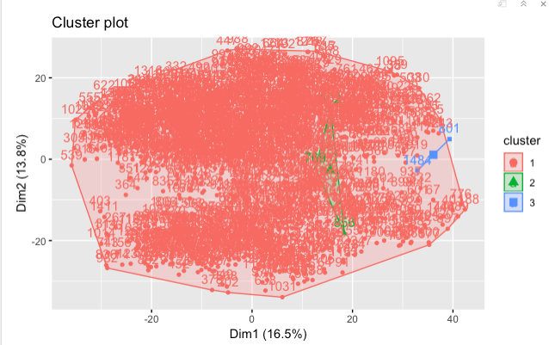
Hierarchical Clustering
Optimal Clusters k = 3
From the plot that we saw only a few observations fall into cluster 2 and 3

Slide 22
Clustering Validation
Use cluster.stats() for comparison between two clustering models
Comparison of cluster average silhouette widths
K-Modes, average silhouette for each cluster is greater than 0.05.
HCLUST, average silhouette for cluster 1 is very low just about 0.0037, but from summary of cluster, we saw majority of observations(1492) are in cluster 1. This means that many points have a very low value, then the clustering configuration may have too many or too few clusters.

Slide 23
Cont.
Comparison of average distance within clusters
K- Modes Clustering 5.516989
Hierarchical Clustering 5.873582
Hierarchical clustering has higher number than K-Modes. That means hierarchical clustering is not good as K-Modes clustering
Conclusion of Comparison
K-Modes clustering is the better model for the segmentation in this categorical dataset. The clustering results are not as good as I expect it, but it did give us useful values for the podcast industry especially the cluster 1 is a very interesting segmentation.

Slide 24


THANK YOU
This Photo by Unknown Author is licensed under CC BY-NC-ND

